Slide 1
READ Program
Russian Education Aid for Development
CICED – Center of International Cooperation for Education Development
RTC – Russian Training Center

Slide 2

READ in Russia “big picture” and progress

Slide 3
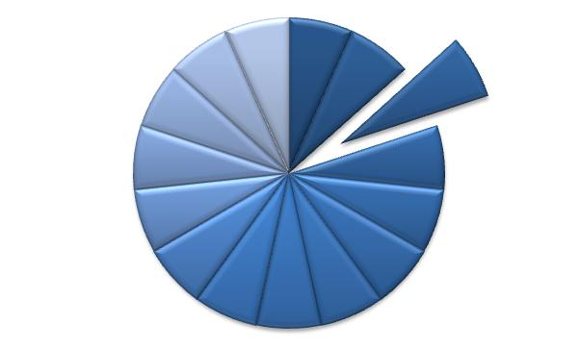
SABER: System Assessment and Benchmarking for Education Results
Student
Assessment
Teacher policies
Standards
Workforce Skills
Notes:
READ Funding has contributed to huge Program at WB. Part of the new Education Sector Strategy– benchmark performance of different subsystems.
This is main story:
- determine what matters,
- develop metrics,
- apply metrics to assess and benchmark,
- use findings from assessments to help countries improve policy.
15 areas

Slide 4
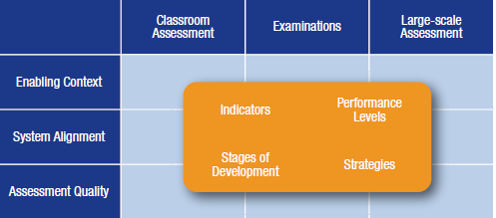
Knowledge Products: SABER – Student Assessment
1) Conceptual Framework

Slide 5
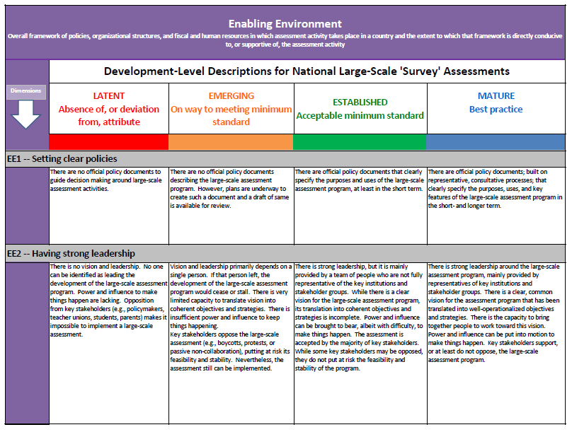
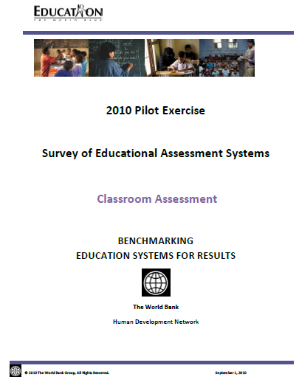
Knowledge Products: SABER – Student Assessment
2) Rubrics and Questionnaires
3) Pilot Exercise of SABER-Student Assessment Benchmarking Tool

Slide 6
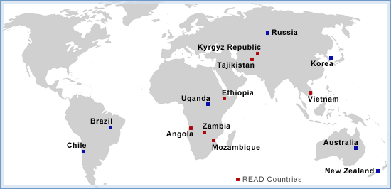
Knowledge Products: SABER – Student Assessment
4) Case Studies – Enabling Context
5) Paper and Database on World Bank Support for the Development of Assessment Systems

Slide 7
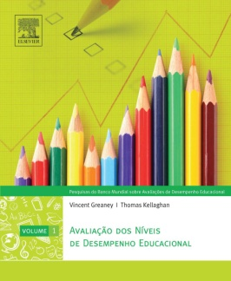

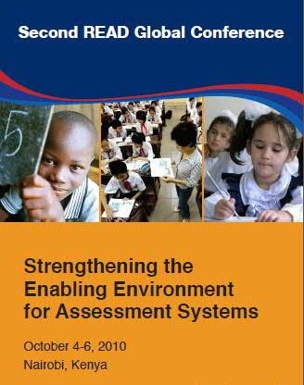
Sharing Lessons Learned
National Assessment of Educational Achievement Series (Portuguese)
“When Children Learn, Nations Prosper” Documentary
Second READ Global Conference in Nairobi, Kenya

Slide 8
GOAL: Support improvement of student learning outcomes through the design, implementation, and use of robust student assessment systems
READ TF Results Framework
KEY INDICATORS:
Enabling Context
EC1 -- Setting clear policies
EC2 -- Having strong leadership
EC3 -- Having regular budget/funds for assessment
EC4 -- Having strong organizational structures
EC5 -- Having effective human resources
System Alignment
SA1 -- Aligning the assessment with learning goals
SA2 -- Providing opportunities to learn about assessment
Assessment Quality
AQ1 -- Ensuring quality
AQ2 -- Ensuring effective use of assessment results
Notes:
Quarterly Update in the form of a newsletter

Slide 9
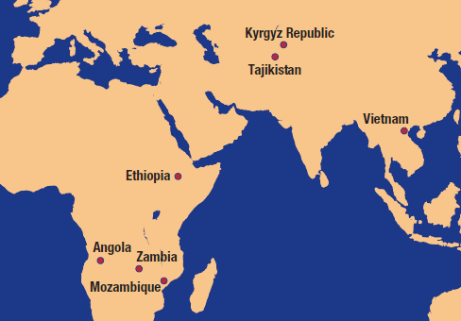
READ Country Action Plans
Notes:
Instead of going alphabetically through them– regionally since they have the most in common
Africa
Central Asia
South East Asia

Slide 10
Proposed READ TF Global Work Program 2011
Developing Knowledge Products/Tools
SABER-Student Assessment
SABER-Standards
Partnering/Sharing Knowledge
PISA International Option
Sharing Lessons Learned
READ Website
Third READ Global Conference
Skills Measurement Tool
Russian Study Visit to READ Country (Development in Practice)
Publications
Promoting READ and SABER-Student Assessments
Notes:
SABER-Standards
PISA 2012-OECD Tool
Communications
Website, Newsletter
Third READ Global Conference

Slide 11
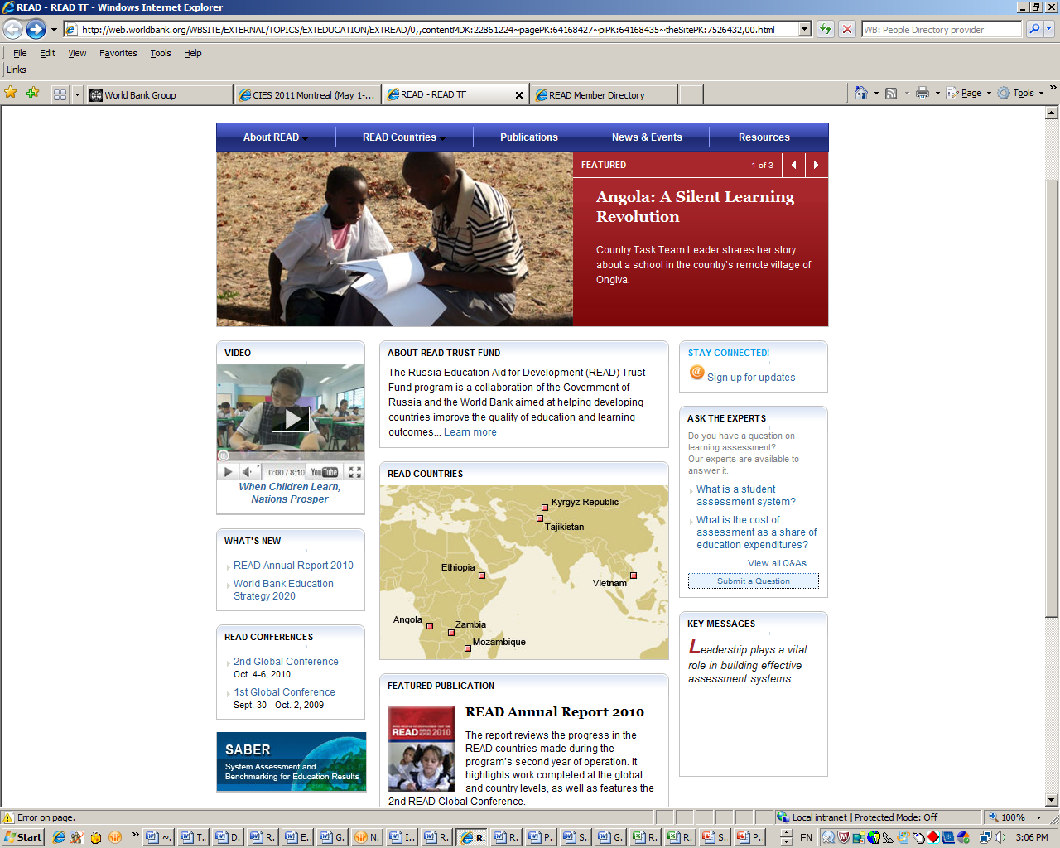
READ Website
Highlights:
Feature Stories
Ask the Expert
Videos
News Items
Partners
Useful resources on assessment
Will be available in Russian
www.worldbank.org/readtf
Notes:
http://web.worldbank.org/WBSITE/EXTERNAL/TOPICS/EXTEDUCATION/EXTREAD/0,,contentMDK:22861224~pagePK:64168427~piPK:64168435~theSitePK:7526432,00.html
Useful resources on assessment (useful links, reports, research papers, statistics resources, etc.)
Video “When Children Learn, Nations Prosper” posted in all three languages
News items (global and local) and events related to assessment
The video page: http://web.worldbank.org/WBSITE/EXTERNAL/TOPICS/EXTEDUCATION/EXTREAD/0,,contentMDK:22890488~pagePK:64168445~piPK:64168309~theSitePK:7526432,00.html
The Resources page: http://web.worldbank.org/WBSITE/EXTERNAL/TOPICS/EXTEDUCATION/EXTREAD/0,,contentMDK:22861239~menuPK:7526450~pagePK:64168445~piPK:64168309~theSitePK:7526432,00.html
A Feature Story: http://web.worldbank.org/WBSITE/EXTERNAL/TOPICS/EXTEDUCATION/EXTREAD/0,,contentMDK:22890228~menuPK:7875193~pagePK:64168445~piPK:64168309~theSitePK:7526432,00.html
A service called "Ask the Experts": http://web.worldbank.org/WBSITE/EXTERNAL/TOPICS/EXTEDUCATION/EXTREAD/0,,contentMDK:22891799~pagePK:64168427~piPK:64168435~theSitePK:7526432~isCURL:Y,00.html
Featured Stories (up to five at the time; currently three)
“Ask the Expert” feature (website visitors can post a question via online form on the website; the answer (provided by the TG member will be posted online within 2-3 business days)
READ will have its own blog on Education for Global Development Blog (http://blogs.worldbank.org/education/)
READ Global Program created its own email account readtf@worldbank.org, and all the information inquiries (via website) will be directed there.
Once the website is launched, the Google Ad Campaign will help bringing traffic to the website
Representation in social networks (Facebook, Twitter) – closer to the Conference to generate content-sharing and interactive communication.
Video dissemination (YouTube, Vimeo, Launch events and mailing)

Slide 12
(ii) Evaluate against benchmarks

Slide 13
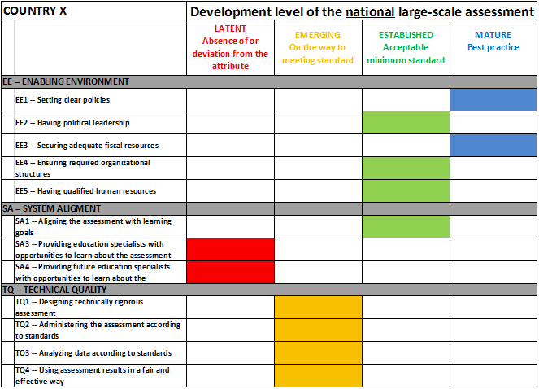
(iii) Summarize findings

Slide 14
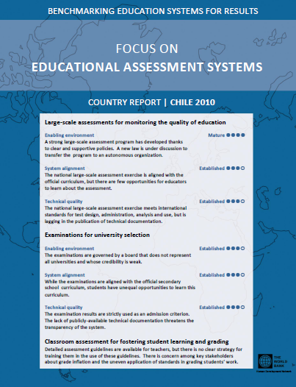
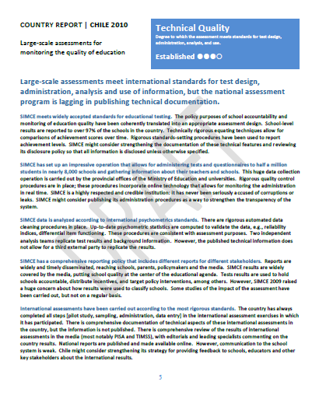
(iv) Report recommendations

Slide 15
1. www.worldbank.org/readtf
2. www.ciced.ru www.ciced.org
tshmis@worldbank.org

